Slide 1
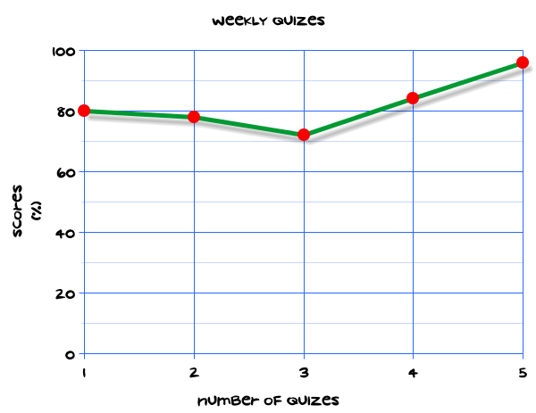
My Statistics Interactive Notebook
Name
Class
Teacher
Term 1 Semester 1
1

Slide 2
Create your own front page
It needs to contain the following –
My number interactive notebook
Name
Class
Teachers Name
Semester 1 Term 1
Page number 1

Slide 3
Contents
Glossary or Formula Page
Page
Date
Description
2
3

Slide 4
Tasks
24
7
30
Essential Question
Questions
Notes
Summary
4
5

Slide 5
24
7
30
Date
Title
EQ –
5

Slide 6
24
7
30
Date
Data Collection and Sampling
EQ –
What are the main things we must do to ensure fair samples are collected?
What is a Sample?
A sample is a smaller (but hopefully representative) collection of data from a population used to determine truths about that population.
Why sample?
Resources (time, money) and workload
Gives results with known accuracy that can be calculated mathematically
5

Slide 7
24
7
30
Date
Data Collection and Sampling
EQ –
What are the main things we must do to ensure fair samples are collected?
What is a Sample?
A sample is a smaller (but hopefully representative) collection of data from a population used to determine truths about that population.
Why sample?
Resources (time, money) and workload
Gives results with known accuracy that can be calculated mathematically
The sampling frame is the list from which the potential respondents are drawn
Geographic area.
Year Level at BSC
Must assess sampling frame errors
5

Slide 8
24
7
30
Date
Data Collection and Sampling
EQ –
What are the main things we must do to ensure fair samples are collected?
What is a Sample?
A sample is a smaller (but hopefully representative) collection of data from a population used to determine truths about that population.
Why sample?
Resources (time, money) and workload
Gives results with known accuracy that can be calculated mathematically
The sampling frame is the list from which the potential respondents are drawn
Geographic area.
Year Level at BSC
Must assess sampling frame errors
What is your population of interest?
This is determined by the data you want to collect. e.g. Data on students’ performance wouldn’t be collected from a worksite.
5

Slide 9
24
7
30
Date
Data Collection and Sampling
EQ –
What are the main things we must do to ensure fair samples are collected?
What is a Sample?
A sample is a smaller (but hopefully representative) collection of data from a population used to determine truths about that population.
Why sample?
Resources (time, money) and workload
Gives results with known accuracy that can be calculated mathematically
The sampling frame is the list from which the potential respondents are drawn
Geographic area.
Year Level at BSC
Must assess sampling frame errors
What is your population of interest?
This is determined by the data you want to collect. e.g. Data on students’ performance wouldn’t be collected from a worksite.
Can you sample the entire population?
Sampling an entire population is very difficult. Generally a Random Sample is taken.
5

Slide 10
24
7
30
Date
Data Collection and Sampling
EQ –
What are the main things we must do to ensure fair samples are collected?
3 factors that influence sample representativeness
Sampling procedure
Sample size
Participation (response)
5

Slide 11
24
7
30
Date
Data Collection and Sampling
EQ –
What are the main things we must do to ensure fair samples are collected?
3 factors that influence sample representativeness
Sampling procedure
Sample size
Participation (response)
When your population is very small
When you have extensive resources
When you don’t expect a very high response
When might you sample the entire population?
5

Slide 12
24
7
30
Date
Data Collection and Sampling
EQ –
What are the main things we must do to ensure fair samples are collected?
3 factors that influence sample representativeness
Sampling procedure
Sample size
Participation (response)
When your population is very small
When you have extensive resources
When you don’t expect a very high response
When might you sample the entire population?
A simple random sample is a subset of individuals (a sample) chosen from a larger set (a population). Each individual is chosen randomly and entirely by chance, such that each individual has the same probability of being chosen at any stage during the sampling process.
What is a Simple Random Sample?
5

Slide 13
Task
Consider the students in your class as the population and suppose they are seated in four rows of 10 students each. To select a sample, you toss a coin. If it comes up heads, you use the 20 students sitting in the first two rows as your sample. If it comes up tails, you use the 20 students sitting in the last two rows as your sample.
Does every student have an equal chance of being selected for the sample? Explain.
Is it possible to include students sitting in row 3 with students sitting in row 2 in your sample? Is your sample random? Explain.
Describe a process you could use to get a simple random sample size of 20 from a class of 40.
Suppose you are assigned the number 1, and each other student in your class calls out consecutive numbers until each person has his or her own number. Explain how you could get a random sample of four students from your class.
Explain why the first four students walking into the classroom would not necessarily form a random sample.
Explain why four students walking in late would not necessarily form a random sample.
3. Discuss with your partner, different ways of getting random samples from various populations. Write three ways down and be prepared to share them with the class.

Slide 14
Notes Review
24, 7 ,30
Date
Title
Essential question
Notes complete
Notes complete with colour and diagrams
Questions completed
Contents page filed in
Formula page filled in

Slide 15
Homework
Review your notes and write a summary answering the essential question.

